Slide 1
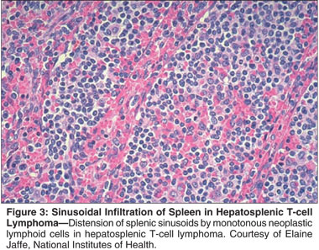
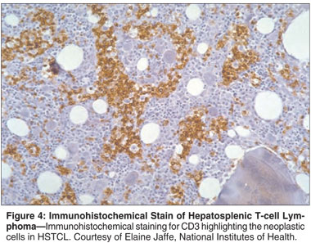

Slide 2
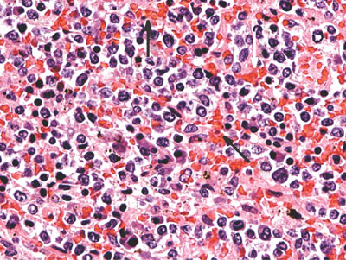
Hypercellularity and abnormal widening of the red pulpa is visible with hyperemia (arrows). Hematoxylin and eosin stain, magnification ｘ400.
Nature Reviews Gastroenterology & Hepatology 6, 433-436 (July 2009)

